Slide 1
Differentiated Service Delivery and TB/HIV Services:
Making Connections, Seizing Opportunities
Wafaa M. El-Sadr, MD, MPH
July 22, 2019

Slide 2
Outline
The TB/HIV Challenge
Making the DSD-TB/HIV Connection
Satellite Agenda

Slide 3
Tuberculosis Mortality
Tuberculosis (TB) is the leading infectious cause of death globally, surpassing HIV
In 2017, 1.6 million people died of TB, including 300,000 people living with HIV
TB is the leading cause of death among people living with HIV and accounts for nearly a third of AIDS-related deaths globally
Source: WHO

Slide 4
Tuberculosis and HIV
Risk of developing TB in people living with HIV is 20 times higher than the risk in the rest of the world population
72% of TB cases among people living with HIV are in Africa
People living with HIV are much more likely to die from TB than HIV-negative people

Slide 5
ART Alone is Insufficient to Prevent TB
ART reduces the risk of developing TB by ~ 65% but despite ART, TB incidence remains between 2- and 10-fold higher among people living with HIV
TB preventive treatment (TPT) has an additive protective benefit in people living with HIV receiving ART
TPT has a survival benefit in people living with HIV on ART
Benefits noted in both early and advanced disease
Survival benefit is durable, even in high burden settings
Suthar, PLoS Med 2013; Kwan, Clin Microbiol Rev 2011; Rangaka et al, Lancet 2014; TEMPRANO ANRS 12136 Study Group, N Engl J Med 2015; Badje et al, Lancet Global Health 2017; Hakim et al, N Engl J Med 2017

Slide 6
TPT Implementation is Suboptimal
Despite the evidence, IPT coverage is low
Of 30M people eligible for TPT in 2017, <1M received it
IPT completion rates are suboptimal
50-70% completion rates in programmatic settings
Commonly cited barriers include:
Concerns about adherence, toxicity, resistance
Supply chain/Stockouts
Requirement for monthly clinical visits

Slide 7
Newer TPT Regimens Hold Promise
Newer TPT regimens (3HP, 1HP) noninferior to standard course of IPT for prevention of TB
Short-course regimens had lower incidence of adverse events
Participants receiving short course regimens more likely to complete treatment
Potential “game changers” in efforts to improve access to and completion of TPT among people living with HIV
Martinson et al, N Engl J Med 2011; Sterling et al, AIDS 2016; Villarino et al, JAMA Ped 2015; Moro et al, Am J Resp Crit Care Med 2016; Swindells et al, N Engl J Med 2019

Slide 8
Outline
The TB/HIV Challenge
Making the DSD-TB/HIV Connection
Satellite Agenda

Slide 9
What is Differentiated Service Delivery?
“DSD is a client-centered approach that simplifies and adapts HIV services across the cascade to reflect the preferences and expectations of various groups of people living with HIV while reducing unnecessary burdens on the health system.”

Slide 10
What is Differentiated Service Delivery?
Service Intensity
Service Frequency
Service Location
Service Provider

Slide 11
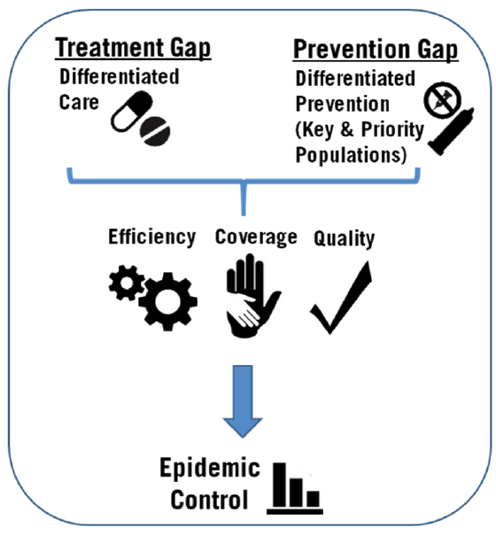
DSD is a means, not an end
Differentiation
Public Health Approach
El-Sadr, Harripersaud, Rabkin PLoS Med 2017
Notes:
Not sure you need this slide, but…

Slide 12
Differentiated ART (DART) Models
More-intensive DART Models
Virologic clinics for people with unsuppressed VL
Intensive follow-up models for pregnant and breast-feeding women
Pediatric models
Less-intensive DART Models
Facility-based Individual Models |  |  | Facility-based Group Models | Facility-based Group Models
Multi-month prescribing + visit spacing |  |  | ART Clubs | ART Clubs
Fast track + visit spacing |  |  | Facility-based Teen Clubs | Facility-based Teen Clubs
Community-based Individual Models |  |  | Community-based Group Models | Community-based Group Models
Outreach model |  |  | Community Antiretroviral Groups (CAGs, CARGs) | Community Antiretroviral Groups (CAGs, CARGs)
Community-based Drug Distribution |  |  | Community-based Teen Clubs | Community-based Teen Clubs
PODI (Community distribution center)

Slide 13
DSD scale up
Many countries are moving to rapidly scale up less-intensive DSD models for people doing well on ART
This means that more and more people will be in models involving fewer and faster visits to the health facility
For example, as of October 2018*:
The Ethiopia MOH estimated that 26% of eligible ART patients (117,000 people) were enrolled in its 6-month appointment spacing model
The Uganda MOH estimated that 21% of all ART patients (242,000 people) were enrolled in one of several less-intensive DART models
* Source = CQUIN annual meeting

Slide 14
The CQUIN Learning Network
The HIV Coverage, Quality, and Impact Network is designed to advance differentiated service delivery with a focus on sub-Saharan Africa
Funded by the Bill & Melinda Gates Foundation
Convened / led by ICAP at Columbia University

Slide 15
CQUIN Activities
CQUIN aims to foster the scale-up of high quality differentiated HIV services by:
facilitating country-to-country knowledge exchange
providing demand-driven technical assistance
supporting catalytic projects and knowledge generation

Slide 16
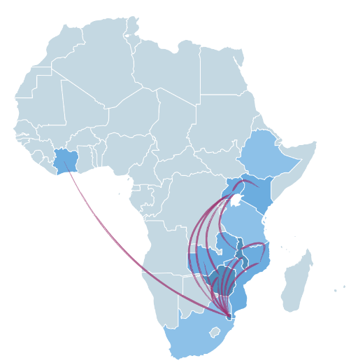
Illustrative CQUIN Activities
South-to-south learning
Meetings and workshops
Website, webinars, journal club, monthly newsletter
South-to-south visits
Online communities of practice
Focused technical assistance
Seconding national DSD coordinator to MOHs
Support for national DSD review meetings
ICAP consultation/TA
Implementation research
Catalytic projects

Slide 17
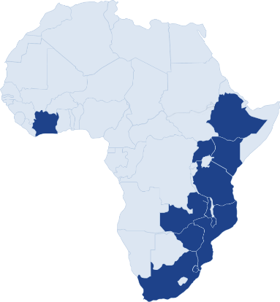
CQUIN Network Members as of 2019
Cote d’Ivoire Ethiopia
Eswatini
Kenya
Malawi
Mozambique
South Africa
Tanzania
Uganda
Zambia
Zimbabwe

Slide 18
CQUIN-WHO workshop on DSD and TB/HIV Services: March 2019
Meeting Report available at:
www.cquin.icap.columbia.edu
120 people from 7 countries
Ministries of Health
Civil Society / Recipients of Care
Donors
Implementing Partners
Global Partners

Slide 19
Illustrative Potential Opportunities Discussed at CQUIN Meeting
Differentiated ART may improve retention in care, providing increased opportunities to provide TB/HIV services over time
Decreasing HCW workloads may increase the likelihood they provide TB/HIV services when recipients of care do come to the health facility
Group models (whether facility-based or community-based) may provide additional peer-led support for TB/HIV services
Decreasing the amount of time spent at health facilities may reduce exposure to TB and decrease TB incidence
Person-centered care may provide new opportunities for empowerment and education, increasing demand for TB/HIV services

Slide 20
Illustrative Potential Challenges Discussed at CQUIN Meeting
Fewer visits to the health facility may reduce the frequency of TB/HIV services
The shift of services to the community may reduce the quality of TB/HIV services
Linkage and up-referral to health facilities may be challenging for people screened in community settings
Innovative approaches are needed for TPT delivery in less-intensive DART models

Slide 21
The DSD-TB/HIV Connection
Differentiated ART services are being rapidly scaled up in CQUIN network member countries and beyond
This is likely to create both opportunities to improve TB/HIV services and potential challenges for TB/HIV service delivery

Slide 22
Outline
The TB/HIV Challenge
Making the DSD-TB/HIV Connection
Satellite Agenda

Slide 23
Satellite Agenda
Part 1 | DSD and TB/HIV: State of the Art
TB screening and DSD – Andrea Howard, ICAP at Columbia University, United States
TB preventive treatment and DSD – Salome Charalambous, Aurum Institute, South Africa
PEPFAR TPT priorities – Hank Tomlinson, CDC Atlanta, Unites States
Highlights from the TB/HIV pre-meeting symposium – Adeeba Kamarulzaman, University of Malaya, Malaysia
Part 2 | Implications of DSD for TB/HIV Services
DSD and TB/HIV services in Zimbabwe – Tsitsi Apollo, MOH Zimbabwe
DSD and TB/HIV services in Uganda – Cordelia Katureebe, MOH Uganda
DSD and TB/HIV services: community perspective – Stella Kentutsi, NAFOPHANU Uganda

Slide 24
Acknowledgments
The Bill & Melinda Gates Foundation
The World Health Organization
CQUIN network member countries

